Slide 1

Automatic plant irrigation system
R.M.K. COLLEGE OF ENGINEERING AND TECHNOLOGY
DHANUSH S

Slide 2
Content slide:
Irrigation
Disadvantages of irrigation
Aim of this project
Components required
Images of the components
Block diagram
Circuit diagram
Working
Advantages
Disadvantages
Implementation or working model

Slide 3
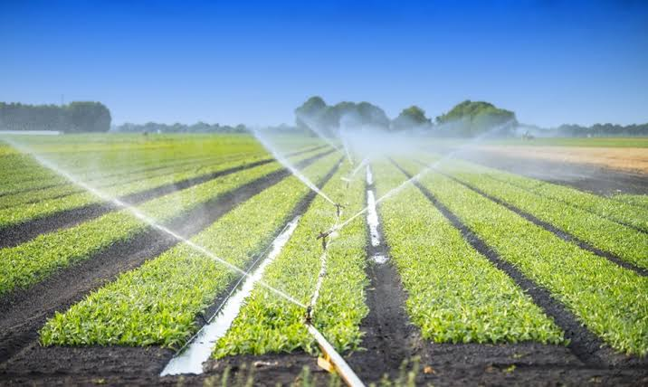
IrrigatioN:
It is a artificial process of supplying water to plants or soil.
Importance of irrigation:
1)It helps in the growth of agricultural crops & because of this the farmers are also beneficial.
2)It may also provide nutrition to the crops.
3)It maintains the landscape & moisture of the soil.

Slide 4
Disadvantages of Irrigation:
Excessive of water is wasted and this creates create water logging.
Salinity and alkalinity of land.
When this water passed to the crops are entering the ponds they pollute the pond water because of the fertilizers added to the crops.
Due to excess supply of water crops may die and this also washes away all minerals present in the soil .

Slide 5
Aim of our project:
Using our project we can limit or reduce the excess of water supplied to the crops.
Using our method only the required amount of water can be supplied to the crops.
It is been found that nearly 60% of water used for agricultural purpose is wasted and so in order to solve this problem we can use this method.
This method also reduces some of disadvantages caused by irrigation

Slide 6
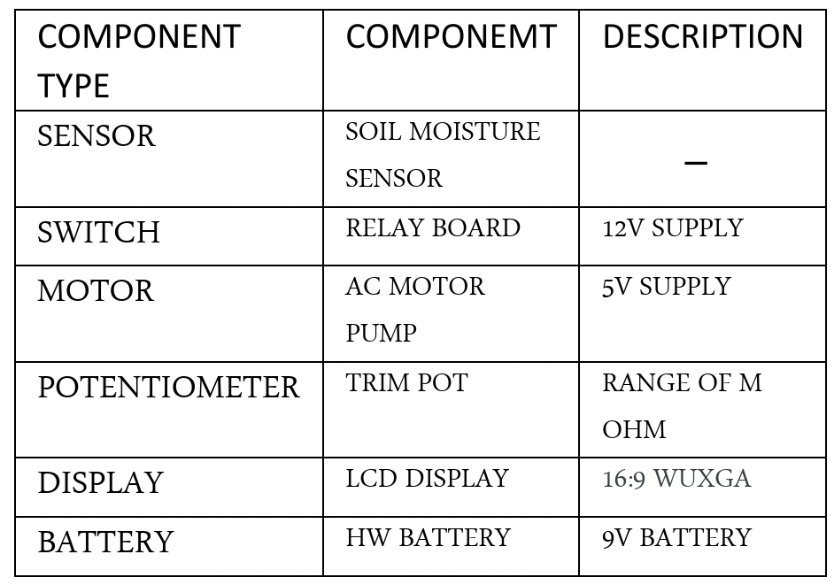
COMPONENTS rEQUIRED:

Slide 7
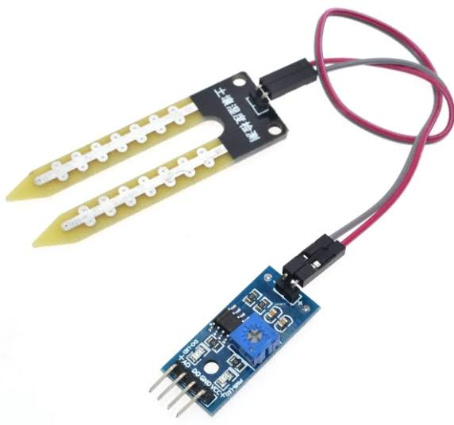
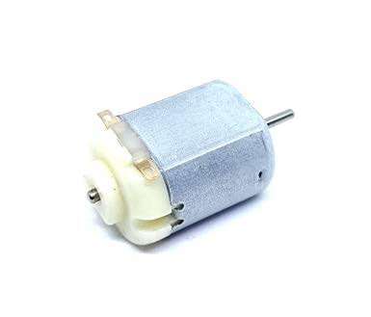
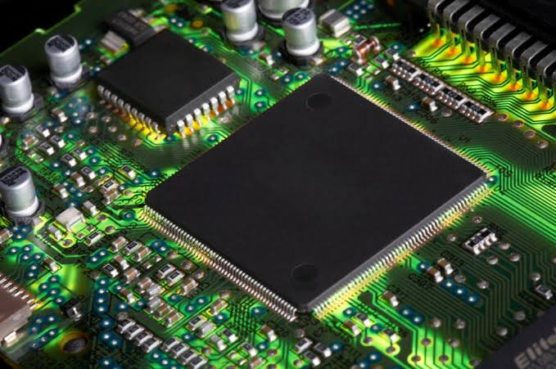
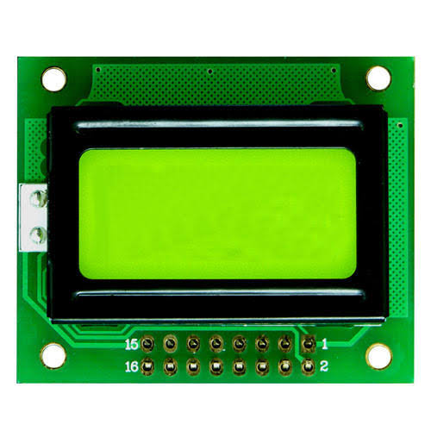
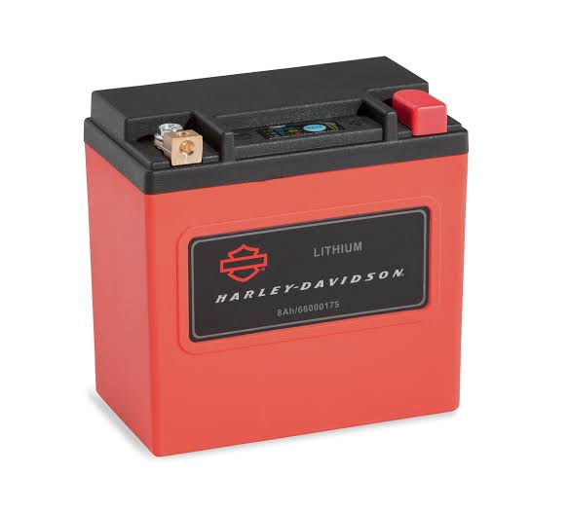
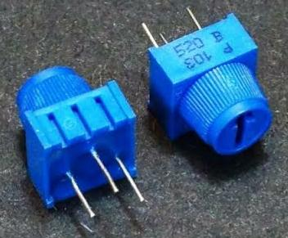
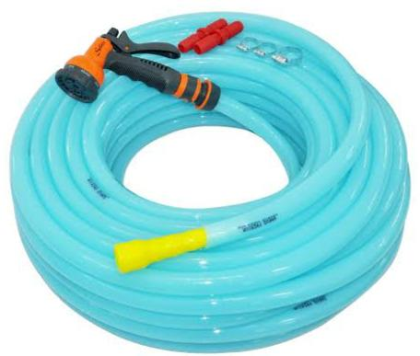
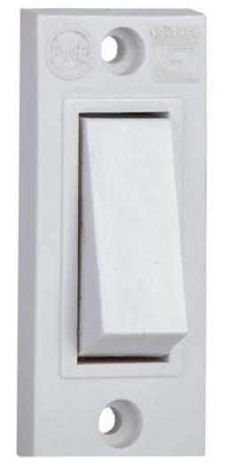
Images of the components:
SOIL MOISTURE SENSOR
MOTOR
MICROCONTROLLER
LCD DISPLAY
WATER SPRINKLER
BATTERY
POTENTIOMETER
SWITCH

Slide 8
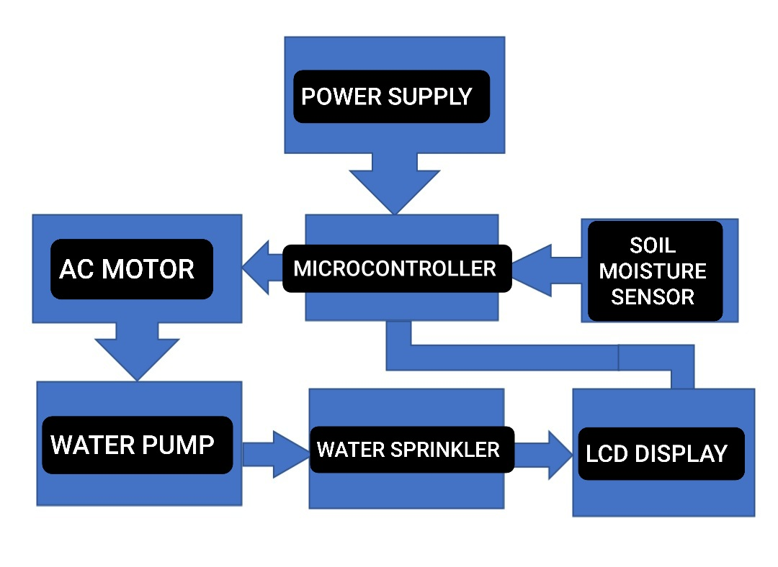
BLOCK DIAGRAM:

Slide 9
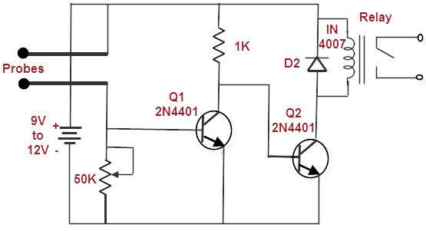
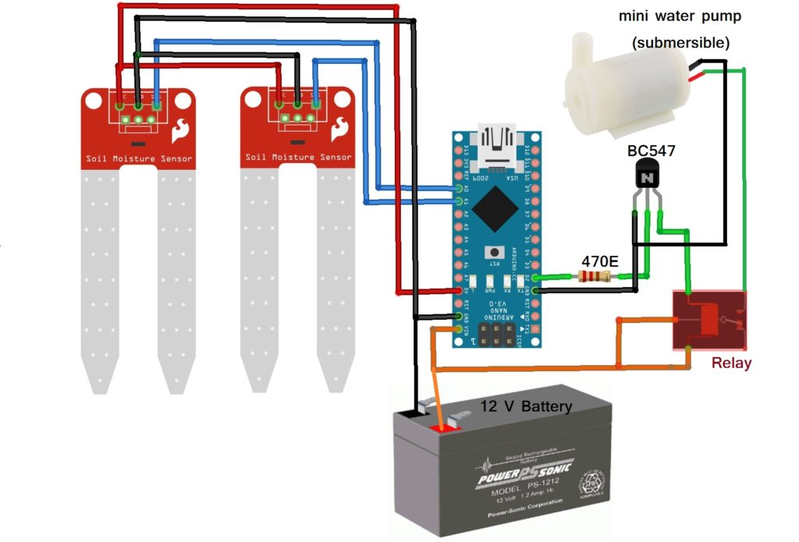
Circuit Diagram of Automatic Plant Irrigation System:

Slide 10
Working:
Soil will have high resistance when it is dry and We use this logic to water the plants and make the circuit work.
This method is basically a soil moisture mmonitoring system ,using moisture sensor the soil moisture can be detected & feed to the microcontroller.
If the sensor value is less then 30% the plants will be watered or else it continues to read the moisture value for irrigation.
Automatic Switches are used to turn on or off the electric AC motor & the watering of the crops is stopped when the required amount is reached.
Using potentiometer the appropriate voltage can be supplied.

Slide 11
Advantages of this method:
It can work according to the moisture content of the soil.
low cost & provides high Performance.
It has automatic turn on & off condition which reduses human work.
It can handle heavy loads.
Consumes less power.

Slide 12
Disadvantages of this method
This method is useful only to the farmers who has large land.
The components used in this device has limited lifespan due to hot climate & detoriation of plastic.
Needs large number of sensing element for irrigation areas.
This system is not 100% reliable so maintanice is needed.

Slide 13
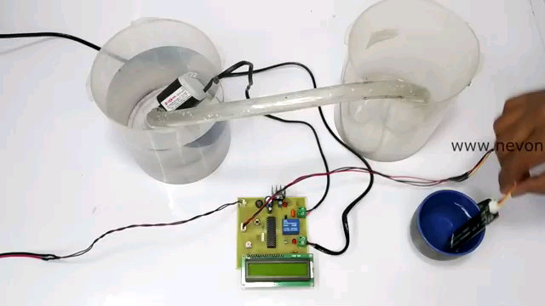
Working model:

Slide 14
THANK YOU

